Slide 1
REWARD BASED KNOWLEDGE SHARING PORTAL
Teach, Learn and Earn

Slide 2
Problem
Knowledge sharing is key for making any organization or team efficient.
People might feel there isn’t enough incentive for them to spend extra efforts on training fellow teammates or others.
The more people participate in teaching and learning from others,
the more skilled they’ll become and this in-turn will reflect in faster
and better solutions which will benefit the organization as a whole.

Slide 3

GOALS
We aspire to promote and encourage knowledge sharing among people working in gainsight.
If we were to succeed in this endeavor then everyone would benefit a lot and it's a great way to make new friends !
#SuccessForAll #Shoshin #StayThirstyMyFriends

Slide 4
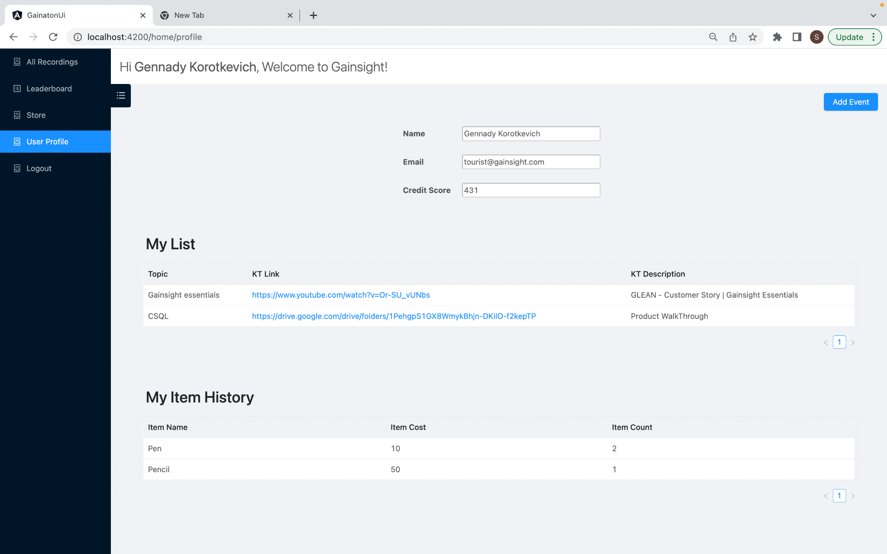
Solution
To build a portal where people can log their sessions and people who spend effort in sharing with others will get points which in turn can be redeemed for exclusive gainsight merchandise!
Merchandise can include anything starting from a pen all the way to t-shirts or hoodies.
What are you planning to share and redeem ?

Slide 5
Demo

Slide 6
Next goals
Integration with GSPMO
Modeling Users as R360 objects and their info
Integration with Slack
Everytime a KT is logged in the portal , a slack notification will be sent
Integration with Udemy
To see user udemy learnings
Integration with GONG
Rank / Badge / special coloured user name
Knowledge sharing events
Much more things from mentees perspective as well.
Dividing content based on product (CS / PX / Insided).
AND SO MUCH MORE ! :D

Slide 7
Thank You

